Slide 1
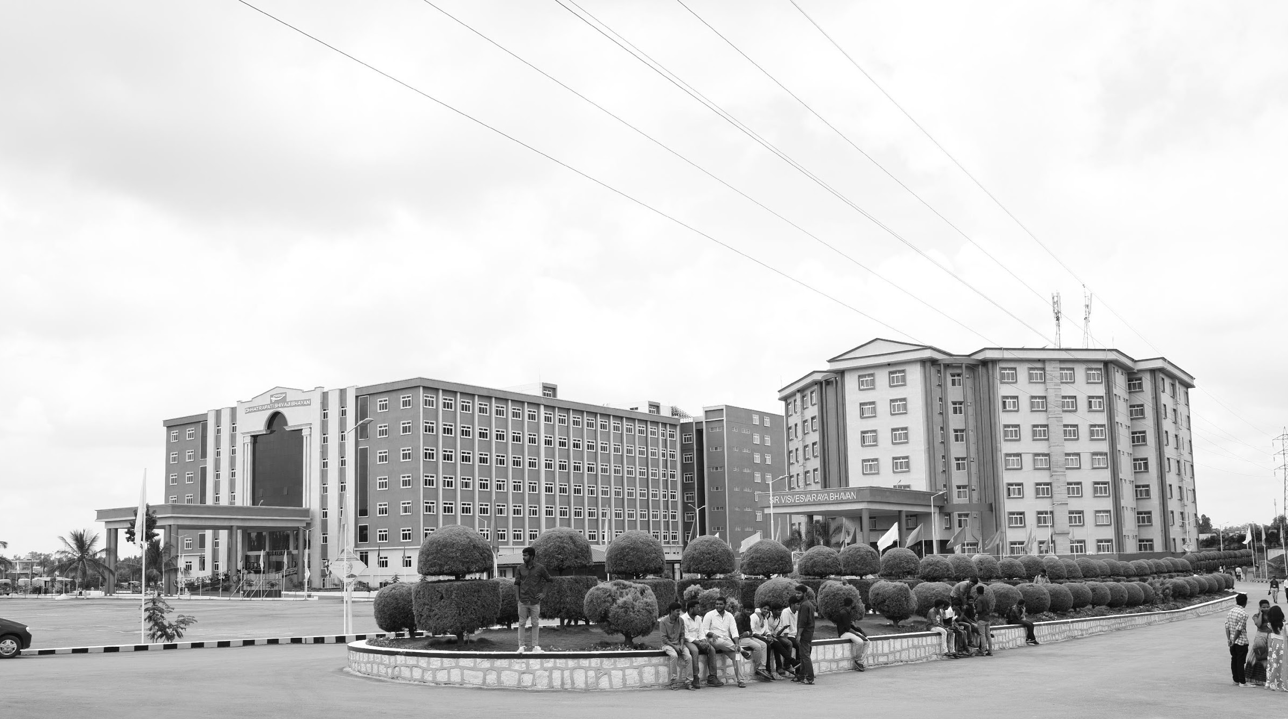
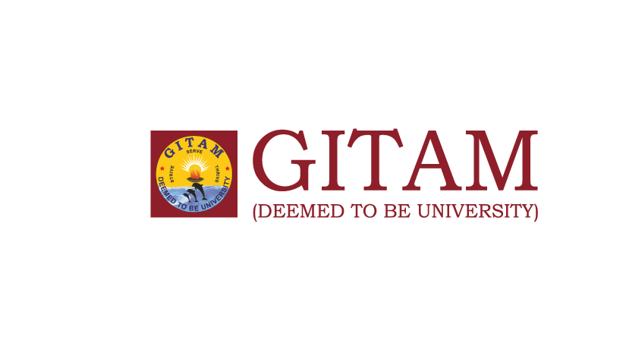
AI Health Care Chat bot using Python
AY 2020-24
GITAM UNIVERSITY
Major Project
A University should be a place of light, of liberty, and of learning.
Department of Electrical Electronics and Communication Engineering
Project Team:
Shaik Anas
Uday Kiran
Sai Sandeep
Project Mentor:
Sundaraman Sir
www.gitamedu.com

Slide 2




Project Group – Details
Photo
Track
Roll No
Name
EECE AI/ML
BU21EECE0100415
K.Uday Kiran
EECE AI/ML
BU21EECE0100434
L.Sai Sandeep
EECE AI/ML
BU21EECE0100102
Shaik Anas

Slide 3
Objective and Goals
Objective
Brief Description
A Python-Powered AI Healthcare Chatbot created to serve users with the following responsibilities:
Symptom Checking: Diagnosing what's wrong and telling you to go see the doc or not
Health Information: General information on diseases, drugs and medication; treatment.
Mental Health Support: Basic counselling and referring to a mental health expert.
Data Collection: To collect health-related data for measurement and sharing with providers
Custom Advice: Providing personal health advice on the basis of user data.
Home Remedies: Advicing Basic Home Remedies without Tablets.
.Key Emergency Guidance: Instant steps for complete emergencies.
These are implemented with the Python using such libraries as NLP, machine learning and web frameworks.
Goals
Main Goals
Home Remedies
Ayurvedic
Personalized Health Advice
Mental Health Support
Reduce Healthcare Costs
Additional Goals
Enhance Access to Healthcare
Information Delivery

Slide 4
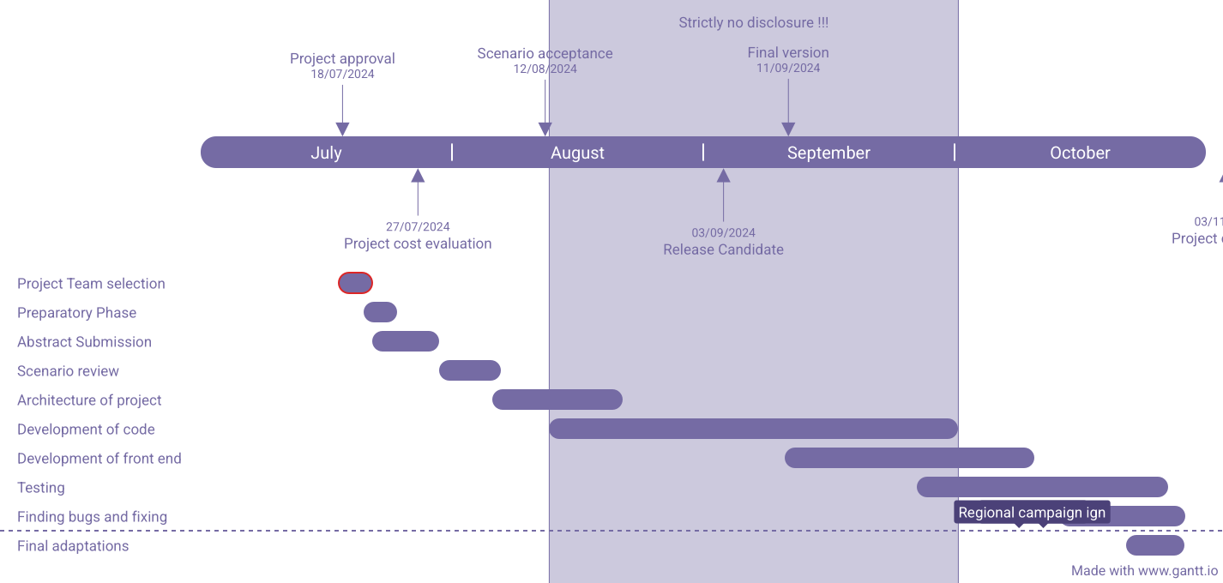
Project Plan
Gant Chart - Milestones and Activities

Slide 5
Literature Survey
PROJECT REFERENCE | DATE OF PUBLICATION | OBJECTIVE
Chat bots is basically interact using text or voice and to get answers using artificial intelligence. A chatbot is a program that is programmed in such a way that it takes some sort of input from the user then it process it using decision tree or some sort of decision making algorithm to give an accurate and desired output to the user | 2022-12-27, journal of pharmaceutial Jagbeer Singh, Vaibhav Deshwal, Sourabh Kumar, Manish Khaloria, Manish Yadav, Priyanshu Negi | This research paper is based on the machine learning algorithm, python sklearn based chat bot and natural language processing for the user and patients for getting precaution and advice for the disease they enter symptoms for.
AI Conversational Chatbot for Primary Healthcare Diagnosis Using Natural Language Processing and Deep Learning | 2021-9-05, Springer, Singapore | Chatbots have progressed to become quite handy in the medical industry for various purposes––predicting diseases, medications, pathology queries, and even just for general medical awareness at much lesser cost and resources
Multilingual Healthcare Chatbot Using Machine Learning | 2021-6-21, Sagar Badlani; Tanvi Aditya; Meet Dave; Sheetal Chaudhari | India faces a huge challenge in terms of managing rural healthcare. Physical consultation, particularly in the rural areas, is costly and time consuming. The solution is adopting healthcare chatbots. The proposed solution describes a multilingual healthcare chatbot application that can perform disease diagnosis based on user symptoms

Slide 6
Analysis - SWOT
Weaknesses
Strengths
Limited Health Domain Expertise
Integration Difficulties
Development Complexity
Ease of Use
24/7 Availability
Automation
Cost Reduction
Threats
Technology Limitations
Legal Risks
Opportunities
Growing AI Adoption in Healthcare:
Potential for Research and Publications
Customization for Specific Niches
Potential for Medical Certifications

Slide 7
Analysis – 4W1H
Why: Improving Access to Health Care, Reducing Health Care Costs, 24/7 Availability, Bridging the Gap in Health Care Delivery In areas with limited access to medical access, a health care chatbot can provide crucial guidance and information.
What: The AI Health Care Chatbot is designed to assist patients and health care providers with various health-related tasks and offering basic symptom assessments. The chatbot utilizes natural language processing (NLP) to interact with users, understanding their queries and providing accurate responses.
Where: Health Care Systems, Web-Based Application, Mobile Application, Remote Areas, Clinics and Hospitals: Initially, the chatbot could be used in smaller clinics.
When: The project will be executed over a period of three months, with key milestones including the design phase, development phase, testing phase, and final deployment.
How: AI & Machine Learning: Python will be used for building machine learning models, particularly for natural language understanding (NLU) to help the chatbot understand user queries, NLP libraries.
Refined Objective: AI Health Care Chatbot project is to develop an intelligent, Python-based system that enhances patient care by providing real-time assistance with health-related queries, symptom assessments, and appointment management. It aims to improve accessibility to reliable health information and reduce the workload on health care providers by automating routine interactions.

Slide 8
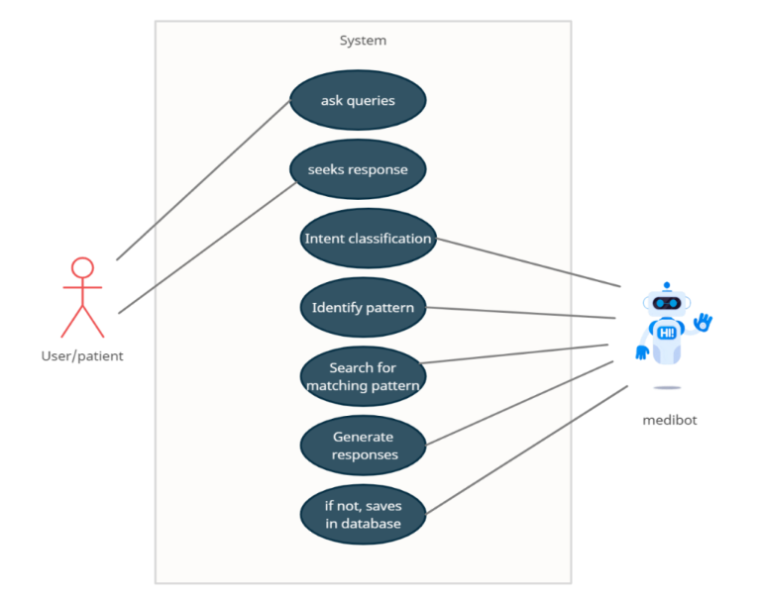
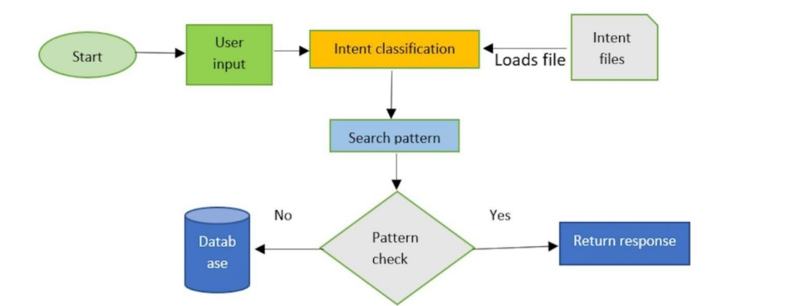
Architecture
Structural Diagram
Block Diagram/Pin Diagram
Behaviour Diagram
Flow chart/ State machine

Slide 9
Conclusion
Summary and Conclusion
The AI Health Care Chatbot represents a significant step toward automating and improving patient care, addressing the growing demand for AI-driven health care solutions. By reducing the burden on health care providers and offering 24/7 access to medical information, the chatbot can enhance both patient experience and operational efficiency. As health care continues to adopt AI technologies, this project has the potential to scale and contribute to the broader landscape of digital health innovation, ultimately improving health outcomes and reducing barriers to care.

Slide 10

THANK YOU

